Slide 1
Representing DAta
Web Services and Applications
Andrew.Beatty@atu.ie
Notes:
XML
https://docs.python.org/3/library/xml.dom.html
https://docs.python.org/3/library/xml.dom.minidom.html
https://realpython.com/python-xml-parser/#xmldomminidom-minimal-dom-implementation
JSON
https://www.w3schools.com/js/js_json_intro.asp
https://www.w3schools.com/python/python_json.asp
XML(older) is how web services used to serve data across the cloud. There's still a few web services that still give XML, so it's worth looking at and JSON is a more modern way, especially with Restful APIs.
Lecture on different ways of representing data.

Slide 2


Many ways to represent DATA
In Software
Variables, Lists, Dicts, Numpy Arrays, etc
Pickle (Serialised Software data structures)
As a Table
Excel (in a file)
SQL Database tables (in a file)
CSV file (human Readable)
As a Text file
Simple Text file
JSON
XML
Lots of other
Charts (there is a whole area on Data Visualisation)

Slide 3
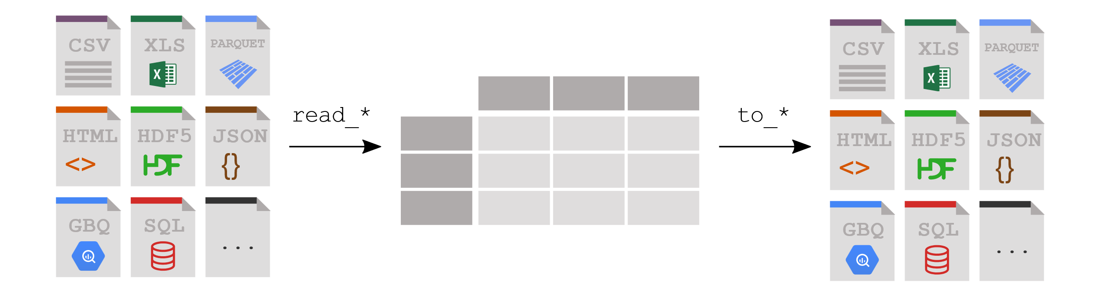

Remember PANDAS
Notes:
basically all data, no matter what format it is, whether it's JSON, CSV, can all be put into a table and then from that table can always be put back out into another format. SQL, GBQ, HTML or whatever.

Slide 4
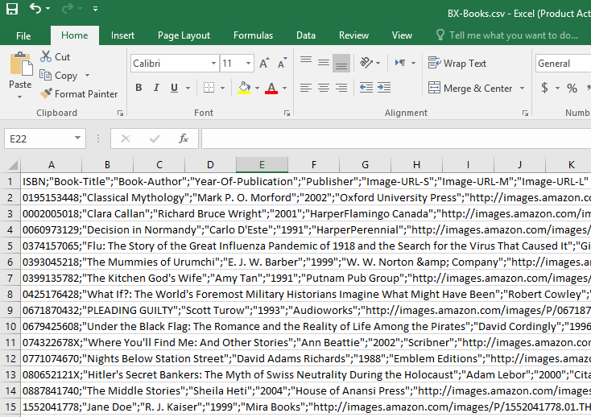
CSV
Notes:
CSV files look like this. I mean this is of course is a semicolon separated file, not a comma separated file, but whether it's tab, or; Or they get just put in the same number CSV because it doesn't matter what the limit is.

Slide 5
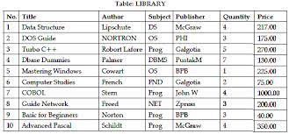
SQL
Notes:
SQL would go into a SQL database. The only thing about SQL tables is they must have a primary key, some unique, one column that's unique identifier,and then they are put into various columns that have various types. So you can't put text into a column that's designed for integers, or you can't put a float into something designed for integers. And you can't put too much too many characters into calling that's only supposed to have 250 characters, SQL is stored in a binary file, and it's optimised so that you can make updates and you can make changes to it as quickly as possible.

Slide 6
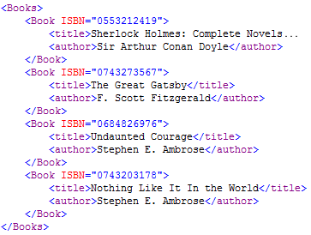
XML
Notes:
XML has tags where they start with an <and they close it A>. In an XML file there's always one root tag. In this case it's books, and then in books, as you can see, there's an array of book. So there's many different book. If this was taken into software, the first one would be element 0 and then element one, element 2 and element 3.

Slide 7
JSON
{
"Books":
[
{
"Title":"the order of the pheonix",
"Author":"JK Rowling",
"ISBN":"1234556677",
"Price": 199
},
{
"Title":"The Goblet of Fire",
"Author":"JK Rowling",
"ISBN":"1234556678",
"Price": 199
},
{
"Title":"Data representation course",
"Author":"Andrew Beatty",
"ISBN":"1234556679",
"Price": 10000099
}
]
}
Notes:
Json is very similar to XML.It's also very similar to your dictionary objects that dictor objects we looked at in programming and scripting. In this case I have books and they're an array and the array of objects and the objects of each of the objects have 4 attributes, title, authorised and price.
in this there's nothing to stop you putting in text in for price or not putting in ISBN. There's nothing to control what data goes in this. There is ways in XML are doing it, Data description tables, which I'm not going to go into.But generally there's no way of controlling what goes into this. So you could put anything in like really

Slide 8
Some Attributes to think about
Human readable or not
How is the data organised (e.g. flat-table vs nested)
This matters when you are storing more than one entity type
Ease of modification (updating)
Efficiency of space (especially for transmission on a network)
Robustness
Notes:
Excel and SQL store things is binary files. Pickle store things as binary files. You can't read that. While XML and JSON they are human readable,you can actually find the data in there. Makes it much easier to debug and also search out the data that you want.
How is the data organised? Is it a flat table like CVS, Excel and SQL or can you nest things in it like we're going to show you later on XML and JSON? You can have arrays inside there.
And how is it to modify SQL? The binary files in SQL are designed to be easily modifiable without having to rewrite the whole file out again. Well, if you modified something in a CSV file, you would have to write out the entire file again. So you could read in an entire CSV file, change something in, and then rewrite the entire file back out again. It's not very efficient for really large bits of data.
there's a lot more characters to store things in an XML site in an XML file than there is in JSON. This is why JSON is used NA lot more for transmission on the networks because it uses far less characters, far less Megabytes store the same amount of data and robustness is just how strong are the data types. can you put wrong data? How easy to put the wrong data into particular column or not have a column? SQL has a whole pile of cheques in that you can put in not null you can There's a whole pile of stuff in databases to make sure the data you put in is correctly. XML has DTDS which I'm not going to look at. JSON doesn't really, so you can put anything you like into JSON.

Slide 9
We will be looking at XML and JSON
Human Readable
Simple
Compact
Nested
Well standardised
Notes:
nested data structure. So you can put arrays of of data into another into another entity. So array of entities into another entity. And they're very well standardised. So pretty much most computing languages have applications or modules that will read in JSON and read in XML and allow you to manipulate them and write them back out again.
Get Current Trains - usage http://api.irishrail.ie/realtime/realtime.asmx/getCurrentTrainsXML
https://cryptocointracker.com/api/coindesk/get/v1-bpi-currentprice-json
https://api.coindesk.com/v1/bpi/currentprice.json

Slide 10
One (MANY) to One….. One (MANY) to Many
Think about how you store many entities that have relationships in a CSV, Excel table or SQL table
One (Many) to one: Store a person and address
Personher
Address
How
Embed (one to one)
Foreign key (many to one)
Name (Primary Key) | Date of Birth | Other | Other
Andrew | 01/01/1970 | Blah | Blah
Address_id | line1 | city | Other
1 | 3 hillside | Gort | f278832
Notes:
when you've got two entities, they can have one of four different types of relationships. They could be 1 to one or many to one or they could be one to many or many to many.
If one person has one address and only one person can stay in each address, that's a one to one relationship. So you could just embed the address into the person.
If two people could be staying at the same address, IE it's a many to one IE two people going to 1 address. Then you do things with a foreign key

Slide 11
Storing a person and their address
One to one embed
Name | DOB | line 1 | City
Andrew | 01/01/1970 | 4 cresent drive | Westport
Joe | 02/02/1980 | 20 snowdrop hill | Darndale
Mary | 03/03/2000 | Cregg Manor | Dalkey
Many to one by foreign key
Name | DOB | Address
Andrew | 01/01/1970 | 1
Joe | 02/02/1980 | 2
Mary | 03/03/2000 | 1
id | line 1 | City
1 | 4 cresent drive | Westport
2 | 20 snowdrop hill | Darndale
Notes:
So Andrew is staying at address one. And then if you look at the addresses, that's for Crescent, Dr made-up address in Westport, Joe is it addressed 2, ID 2, which is 20, Snowdrop Hill, Darndale. And Mary who's just moved from Dalkey, she's staying in with Andrew, UH, she is in address one as well. So that's how you would do a many to 1. So many people could be staying at 1 address or primary address.

Slide 12
One (many) to many
For example students and their modules
Student
Module
How could you connect them
Reverse the relationship and use Foreign key in the modules
Have a bridging table
In software you would use an array.. So you can with XML and JSON
Name (Primary Key) | Date of Birth | Other | Other
Andrew | 01/01/1970 | blah | blah
Name (Primary Key) | Credits | Other | Other
Math | 10 | blah | blah
Notes:
For example, students can have many modules.
In theory you could reverse it and sort of say well we'll put the following key into module and say module is doing, taught by this person, let's say a teacher, so the teacher. You could put the ID of the teacher into the module. So actually kind of reverse it.
So you're probably going to have many students in many modules. And for that you need a bridging table.

Slide 13
One to many reversed
Name (primary key) | DOB
Andrew | 01/01/1970
Joe | 02/02/1980
Mary | 03/03/2000
Name (Primary Key) | Credits | Person
Maths | 10 | Andrew
Data representation | 5 | Andrew
Physics | 5 | Mary
Many to many by Bridging table
Name (primary key) | DOB
Andrew | 01/01/1970
Joe | 02/02/1980
Mary | 03/03/2000
Module_id | Person_id
Maths | Andrew
Data Representation | Andrew
Maths | Mary
Physics | Mary
Name (primary Key | Credits
Maths | 10
Data representation | 5
Physics | 5
Notes:
So instead of it being a one to many, you make it a many to one, you reverse it.So Andrew, Joe and Mary are three different lecturers, let's say, and maths is taught by Andrew. Daily representations taught by Andrew in Physics is taught by Mary.
That won't work for students of course, because you will have many students in a module, so that's a many to many relationship.
bridging table where you have the module Maths is taught is got Andrew in it, the module data representation has got Andrew in it, the module Maths has got Mary in it and the module Physics is Mary in it. So as you can see Maths has two people in it and Mary is doing 2 modules.

Slide 14
In Python
Modules = {
"Maths" : {credits:"10" },
"Data Representation" : {credits:"5" },
"Physics": {credits:"5" }
}
Students = {
"Andrew":{ "modules" : ["maths", "Data Representation"]},
"Mary" : { "modules" : ["maths", "Physics"]}
}
print(Students)
Notes:
if we're doing this in Python, 19 minutes 33 seconds
then you would have to have modules with some kind of primary key. So I've just made an object called modules, and the names are the primary key and they'll have objects associated with them that have data. So maths credits, data representation and physics.And then students would have the modules would be an array and they would link to the keys of the different modules And then if you printed that out.

Slide 15
Some things to think about. Stand up and Stretch

